Slide 1
Control Engineering

Slide 2
Elements of Modelling

Slide 3
Physical Systems
Physical systems can be classified into various types:
Electrical systems
Mechanical systems
Electronic systems
Hydraulic systems
Thermal systems
Each of these systems can be modelled in terms of certain basic
elements
Basic elements of all physical systems can be shown to be analogous
3

Slide 4
Electrical Systems
Based on the type of source, electrical systems can be classified as:
Voltage sourced systems
Current sourced systems
Voltage sourced | Current sourced
Basic System Elements
Resistor (𝑅) | Resistor (𝑅)
Inductor (𝐿) | Inductor (𝐿)
Capacitor (𝐶) | Capacitor (𝐶)
Basic System Variables
Voltage (𝑉) | Current (𝐼)
Charge (𝑄) | Flux (𝜙)
4

Slide 5



Electrical System Elements
Resistor (𝑅): It is an element which resists the flow of current in an
electrical system
𝑉 = 𝐼𝑅
𝑅
Inductor (𝐿): It is an element that stores electrical energy in a magnetic field
𝑑𝜙 𝑑𝐼
𝑉 = _{𝑑𝑡} = 𝐿 _{𝑑𝑡}
𝐿
Capacitor (𝐶): It is an element that stores electrical energy in a electrical field
𝑑𝑞 𝑑𝑉
𝐼 = _{𝑑𝑡} = 𝐶 _{𝑑𝑡}
𝐶
:
Anuj
5

Slide 6
Mechanical Systems
Classification based on type of motion:
Translational systems having linear motion
Rotational systems having angular motion about a fixed axis
Translational | Rotational
Basic System Elements
Mass (𝑀) | Inertia (𝐽)
Damper (𝐵) | Damper (𝐷)
Linear spring (𝐾) | Torsional spring (𝐾)
Basic System Variables
Force (𝐹) | Torque (𝑇)
Displacement (𝑥) | Angular displacement (𝜃)
Anuj
11

Slide 7
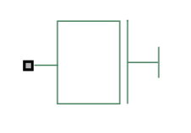

Mass Vs Inertia
Mass
Property of an element that stores the kinetic energy due to translational motion
When a force is acting on a body of mass 𝑀 causing displacement 𝑥, then:
Inertia
Property of an element that stores the kinetic energy due to rotational motion
When a torque is acting on a body of inertia J causing displacement 𝜃, then:
𝐹 = ^{𝑑𝑃} = 𝑀 ^{𝑑2 𝑥} = 𝑀𝑥
𝑑𝑡 𝑑𝑡²
𝑑² 𝜃
𝑇 = 𝐽 = 𝐽𝜃
𝑑𝑡²
𝑇
𝐹
𝑀
𝐽
𝑥
𝜃
:
12

Slide 8
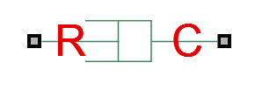
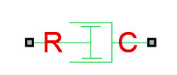

Damper
Damper is an element that generates force which acts opposite to the direction of motion, translational or rotational
Damper resists motion
Friction or dashpot are examples of dampers
Translational Rotational
𝐹
𝑥
𝑇
𝜃
𝐵
𝐷
𝑑𝑥
𝐹 = 𝐵 = 𝐵𝑥
𝑑𝜃
𝑇 = 𝐷 _{𝑑𝑡} = 𝐷𝜃
𝑑𝑡
Photos Courtesy
:
Note: R&C represent ports

Slide 9

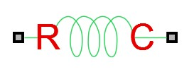
Linear Vs Torsional Spring
Linear Spring
Property of an element that stores the potential energy due to translational motion
When a spring of spring constant
𝐾 is applied a force 𝐹 causing an elastic displacement 𝑥, then:
𝐹 = 𝐾𝑥
𝐹
𝑥
𝐾
Torsional spring
Property of an element that stores the potential energy due to rotational motion
When a torsional spring of constant
𝐾 is applied a torque 𝑇 causing an angular displacement 𝜃, then:
𝑇 = 𝐾𝜃
𝑇
𝜃
𝐾
:
Noe: R&C represent ports

Slide 10
Nodal Analysis for Mechanical Systems
System structure should be modified to suit nodal analysis, without loss of system characteristics
Steps of nodal analysis are detailed by an example
Anuj
15

Slide 11
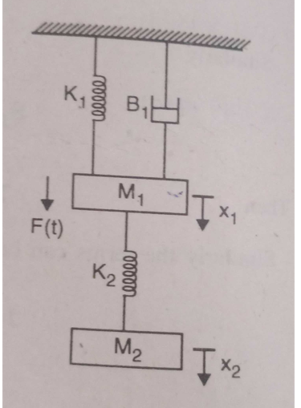

Slide 12
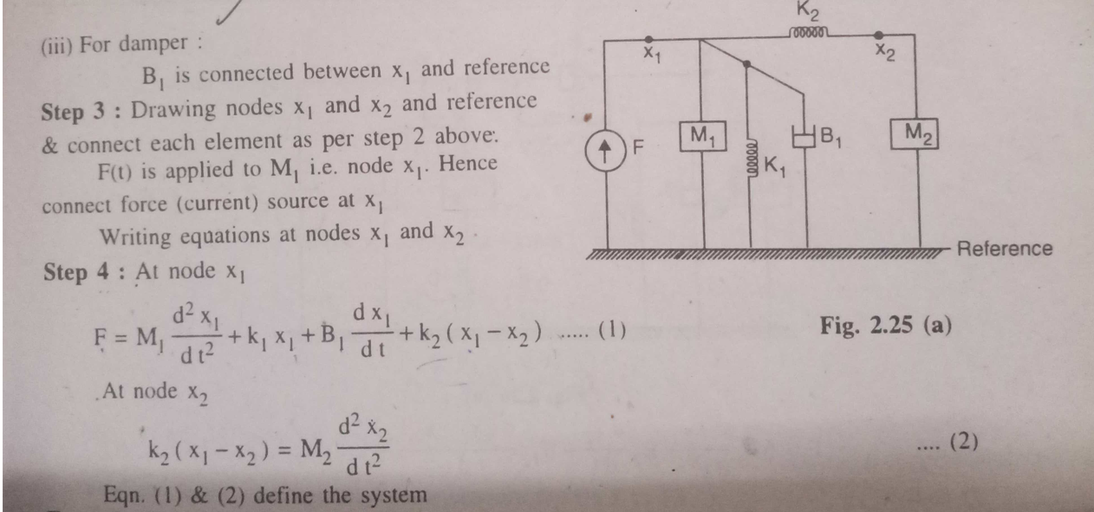

Slide 13
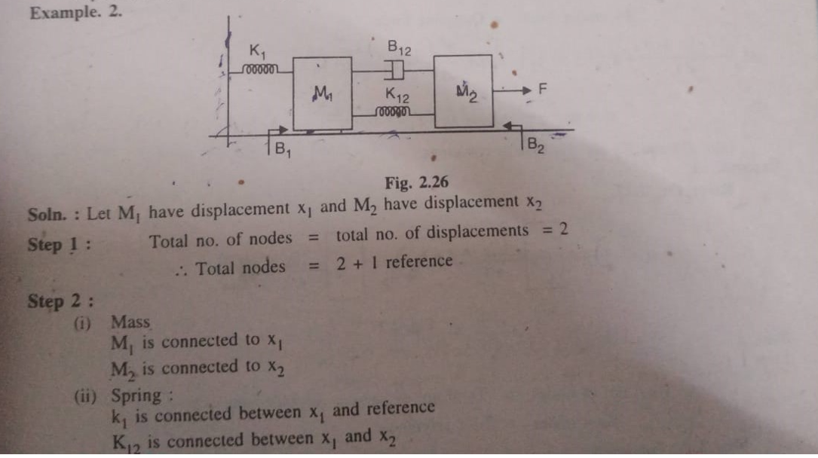

Slide 14
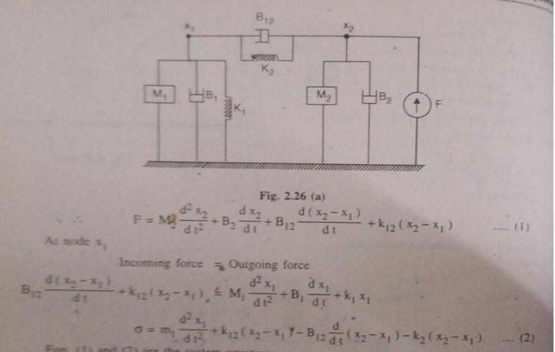

Slide 15
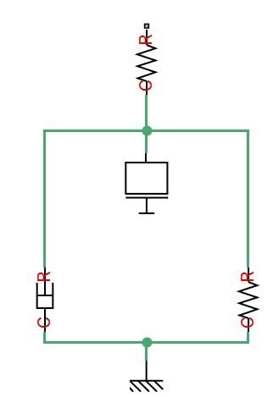
Nodal Analysis : Example
Node 1
𝐹
𝐾₁
Node 2
Step 1:
Number of nodes = 2
Hence, number of displacements = 2
𝑀
𝐵
𝐾₂
Reference
Photos Courtesy
:

Slide 16
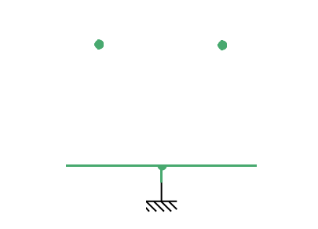
Nodal Analysis : Example
𝑥₁
𝑥₂
Step 2:
Displacement and reference nodes are
identified
Reference Node
:

Slide 17
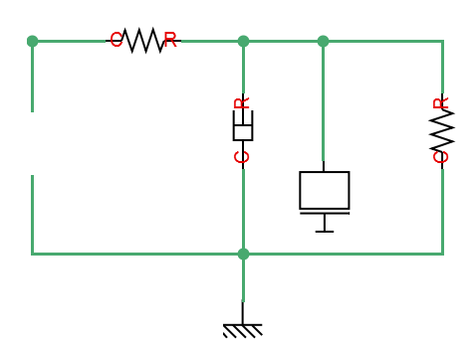
Nodal Analysis : Example
Step 3:
Connect mass 𝑀 between
node 𝑥₂ and reference node
𝑥₁
𝑥₂
𝐾₁
Step 4:
𝐾₂
Connect spring 𝐾₁ between
nodes 𝑥₁ and 𝑥₂
Connect spring 𝐾₂ between
𝑥₂ and reference node
𝐹
𝐵
𝑀
Step 5:
Reference Node
Connect the force 𝐹 between 𝑥₁ and reference node
:

Slide 18
Nodal Analysis : Example
Step 6:
𝑥
𝑥₂
Apply Newton’s 2nd law at node 𝑥₁:
𝐹 = 𝐾₁ 𝑥₁ − 𝑥₂ (1)
1
𝐾₁
𝐾₂
Apply Newton’s 2nd law at node 𝑥₂:
𝐹
𝐵
0 = 𝑀𝑥 + 𝐵𝑥 + 𝐾 𝑥 − 𝑥 +
𝑀
2 2 1 2 1
𝐾 𝑥 (2)
2 2
Eq.1 and Eq.2 give the mathematical model of the given mechanical system
Reference Node
:

Slide 19
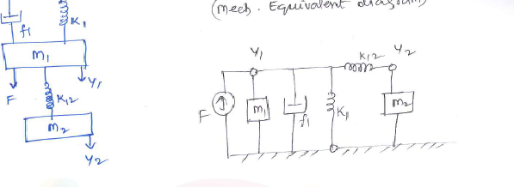

Slide 20
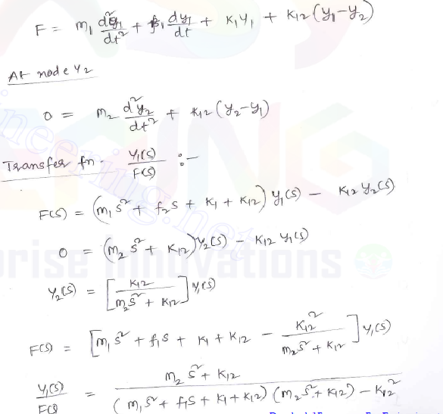

Slide 21
Summary: Steps of Nodal Analysis
Identify number of nodes which is equal to number of displacements
Take a reference node independent of other nodes (displacement nodes)
Connect all mass / inertia elements between the relevant displacement node and the reference node irrespective of its position
Connect spring and damper elements between relevant nodes based on their position
Connect force or torque between the relevant displacement node and the reference node
At each of the displacement nodes, apply Newton’s laws of motion

Slide 22
Analogous Systems
Mechanical systems can be represented using electrical elements
by the following analogies
Two types of analogies:
Force (Torque) - Voltage analogy (F-V analogy)
Force is analogous to voltage
Force (Torque) - Current Analogy (F-I analogy)
Force is analogous to current

Slide 23
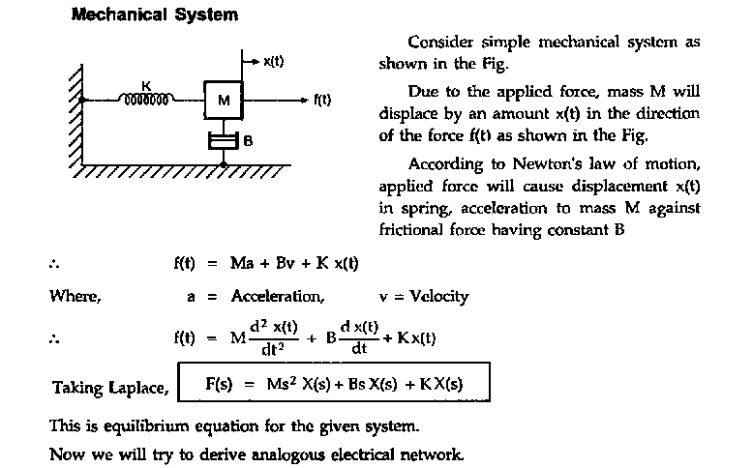

Slide 24
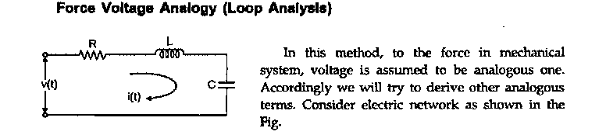

Slide 25
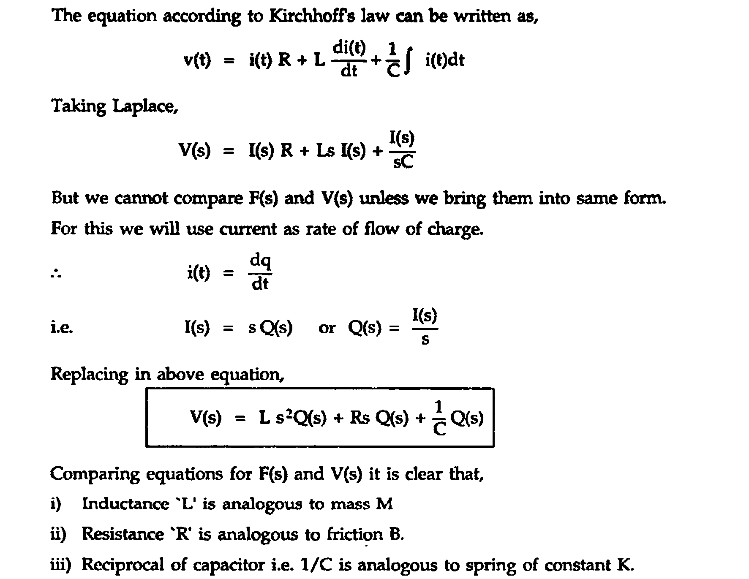

Slide 26
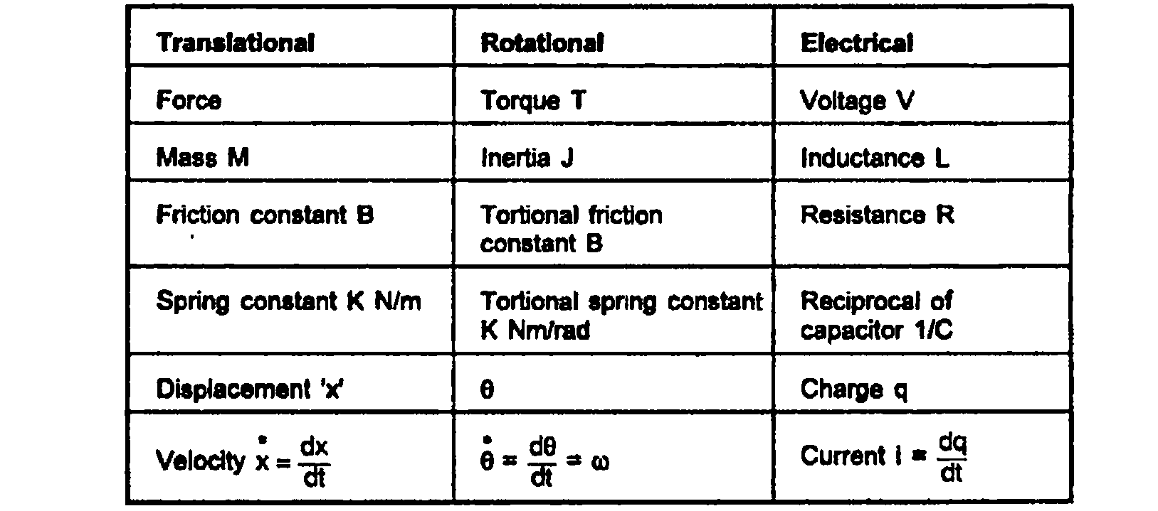

Slide 27
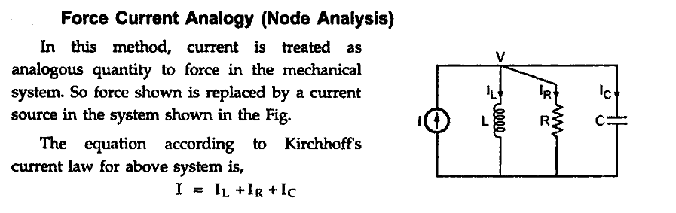

Slide 28
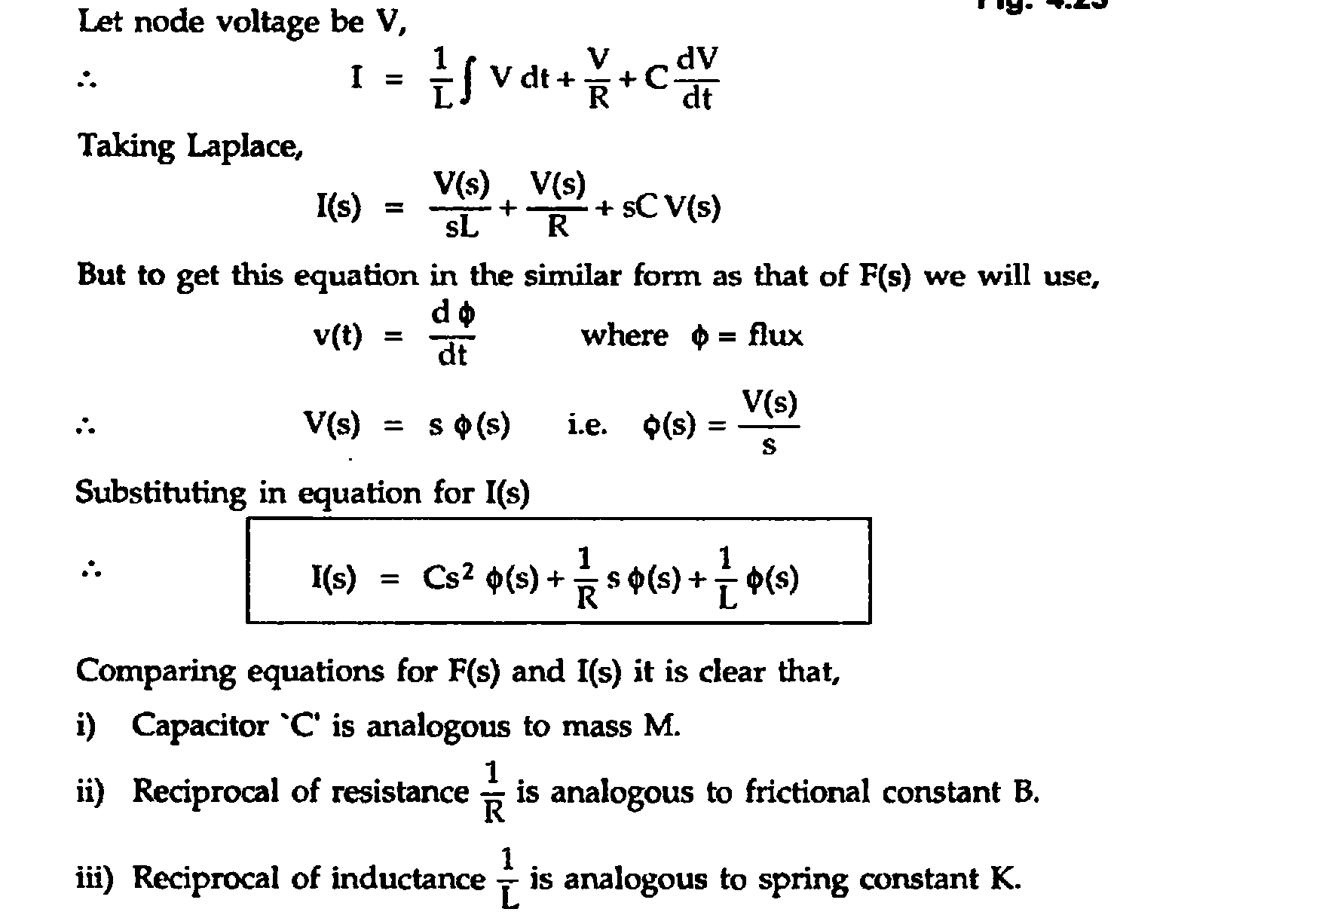

Slide 29
Summary: Analogous Systems
Following table shows the analogue between the elements of mechanical and electrical systems:
Mechanical System |  | Electrical System
Translational | Rotational | F-V Analogy | F-I Analogy
Force (𝐹) | Torque (𝑇) | Voltage (𝑉) | Current (𝐼)
Mass (𝑀) | Inertia (𝐽) | Inductor (𝐿) | Capacitor (𝐶)
Friction (𝐵) | Friction (𝐷) | Resistor (𝑅) | Conductor (1/𝑅)
Linear spring (𝐾) | Torsional spring (𝐾) | Capacitor (1/𝐶) | Inductor (1/𝐿)
Displacement (𝑥) | Displacement (𝜃) | Charge (𝑞) | Flux (𝜙)
Anuj
25

Slide 30
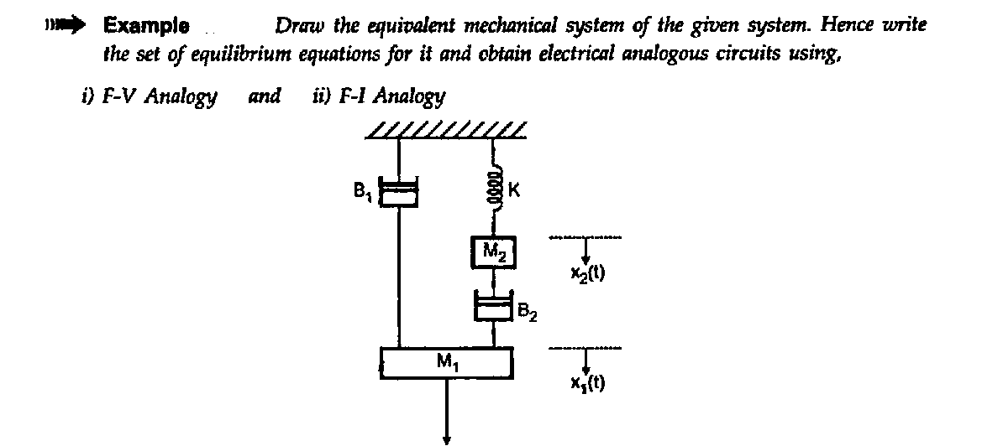


Slide 31
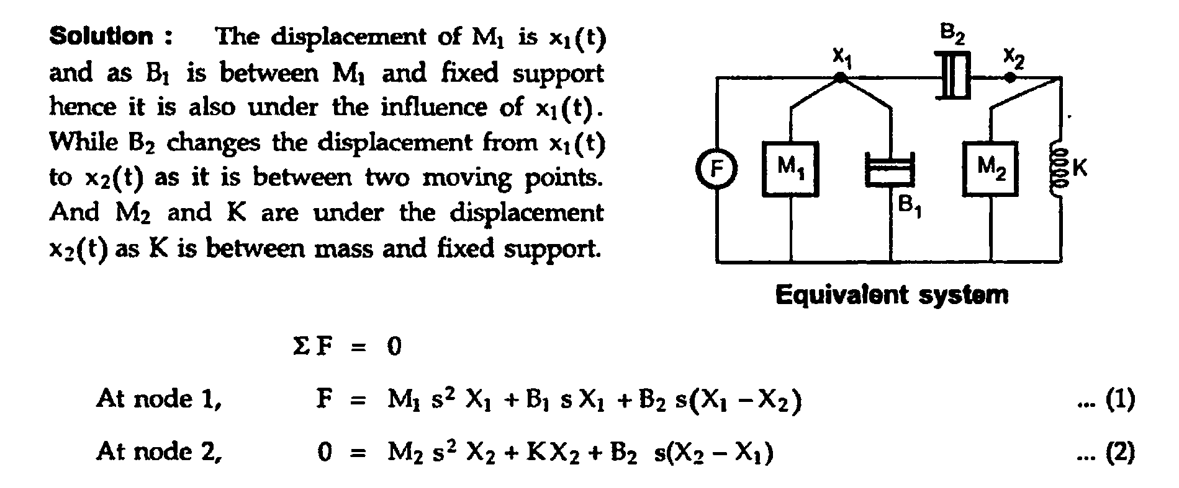

Slide 32
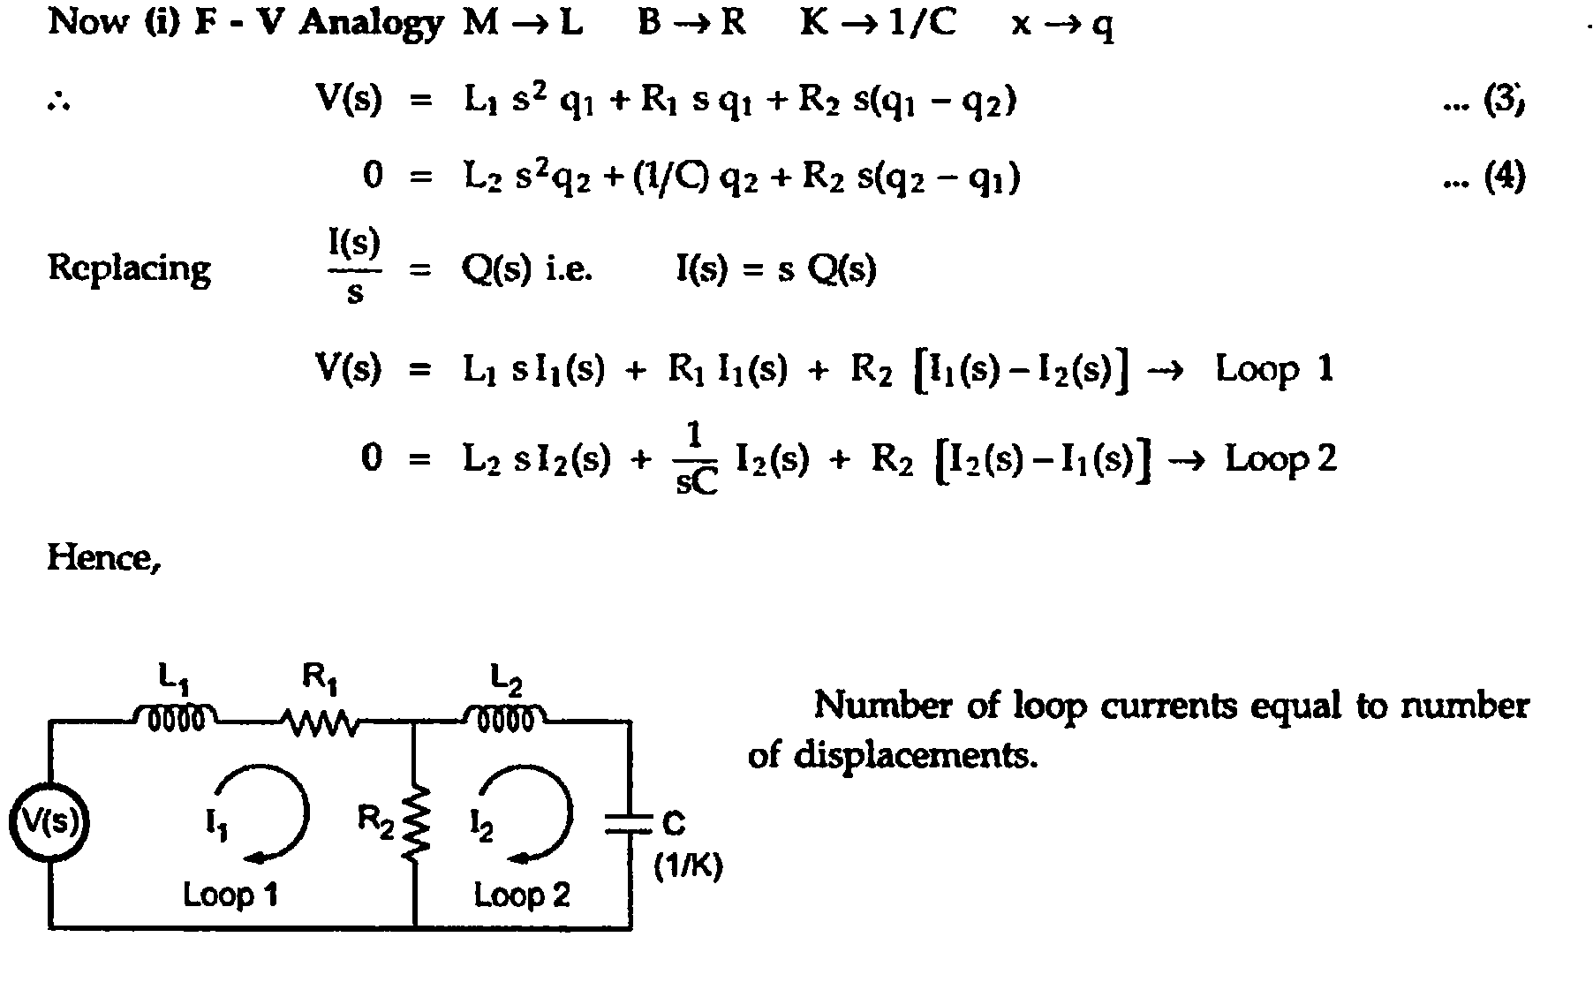

Slide 33
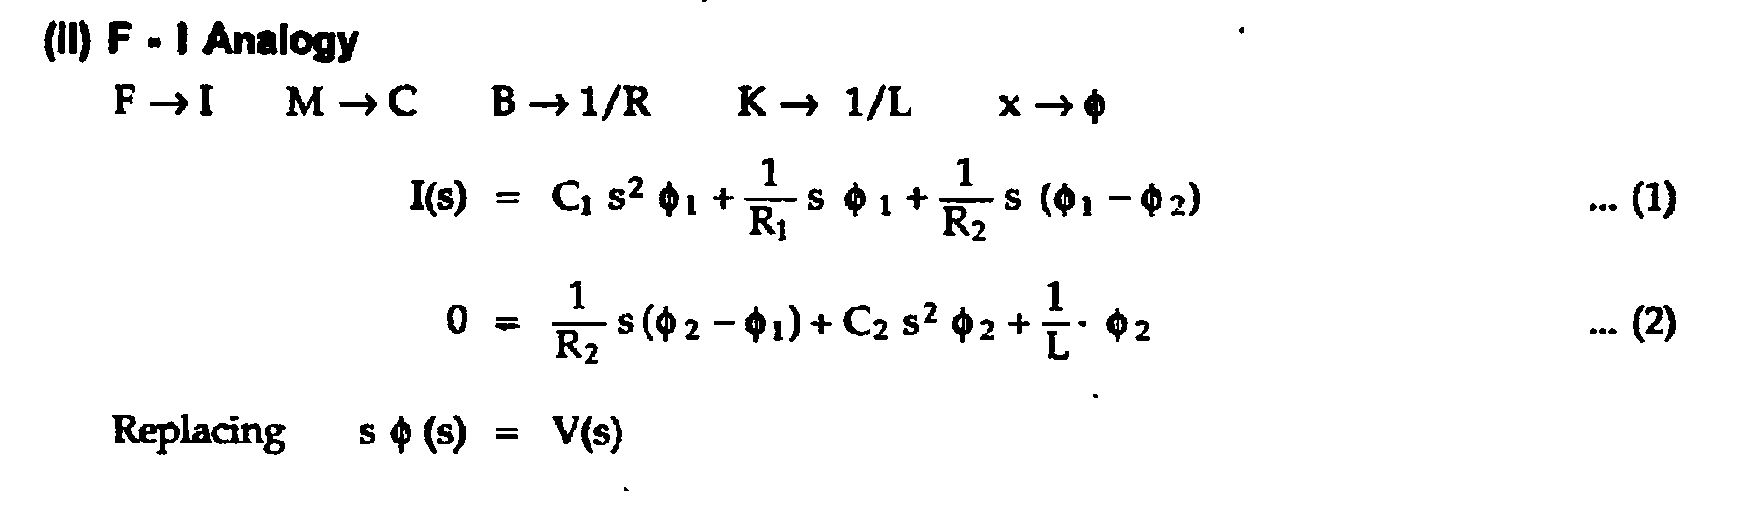
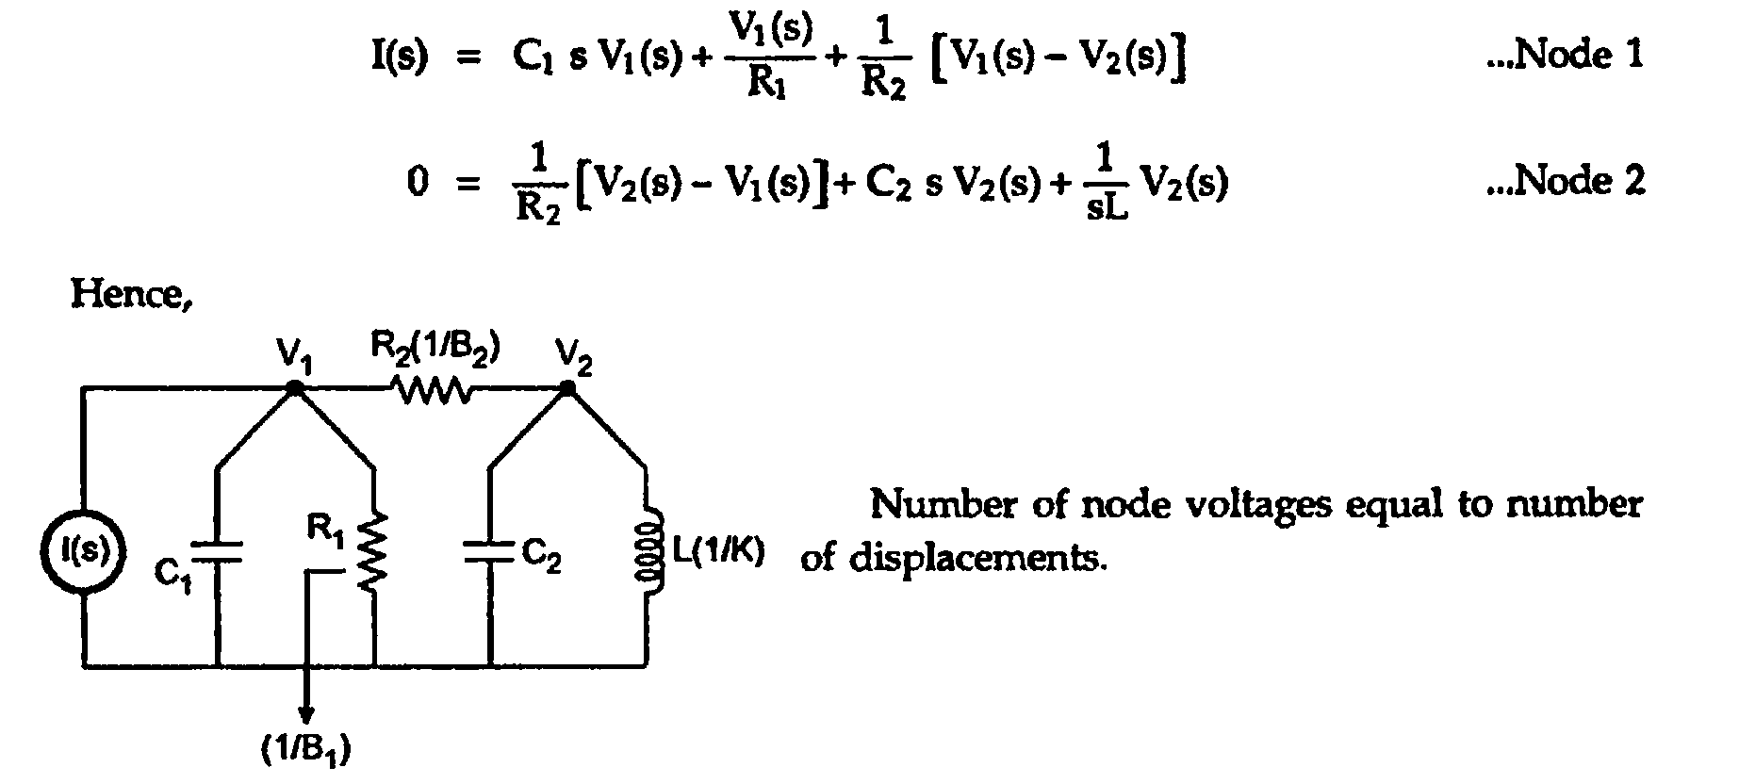

Slide 37
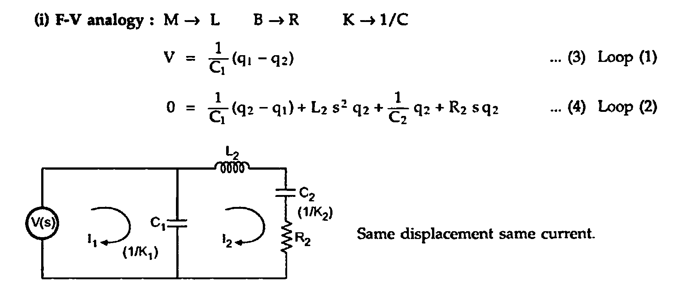

Slide 38
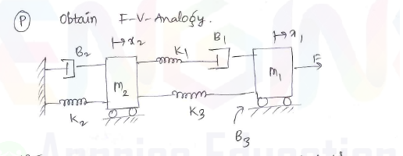

Slide 39
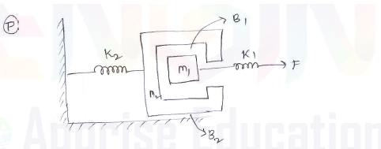

Slide 40
If a pole is located at s = -5 in left-hand plane (LHP), how will it be represented in Laplace domain?
a. 1/ s + 5 b. 1/ s – 5 c. s/ s + 5 d. s/ s – 5

Slide 41
ANSWER: (a) 1/ s + 5

Slide 42
